Slide 1




HATE SPEECH
DATA ANALYTICS

Slide 2
”WORDS HAVE POWER.
HATE SPEECH IS THE
WEAPONIZATION OF LANGUAGE"

Slide 3
PROJECT INTRODUCTION
Today, we delve into the critical intersection of hate speech and data analytics. Hate speech poses a significant societal challenge, impacting communities worldwide. Through advanced data analytics, we aim to not only understand its prevalence and patterns but also to develop effective strategies for prevention and mitigation.

Slide 4
Data analytics plays a crucial role in combating hate speech for several reasons:
01 - UNDERSTANDING PATTERNS
02 - SCALE AND SPEED
03 - TARGETED INTERVENTIONS

Slide 5
04 - UNDERSTANDING USER BEHAVIOR
05 - TRACKING TRENDS AND HOTSPOTS

Slide 6
DATASET

Slide 7
DATASET
For the project we have analysed two types of data: hate phrase lists and hate speech data. Hate phrase lists were taken from t-davidson’s GitHub repository, while hate speech data included offensive remarks sourced from Twitter, notably the Hugging Face dataset.
Dataset: https://huggingface.co/datasets/tdavidson/hate_speech_offensive
Dataset: https://github.com/t-davidson/hate-speech-and-offensive-language/blob/master/lexicons/refined_ngram_dict.csv

Slide 8
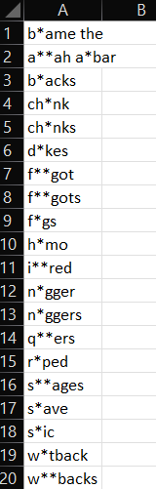
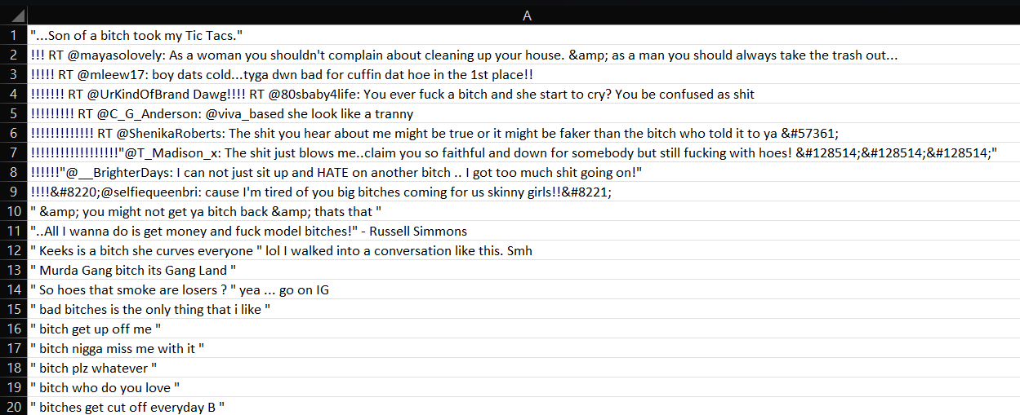

Slide 9
METHODS

Slide 10
These are the core functions of our project which will contribute more in the project.
The makeListHateTermFrequencies method, encapsulated within a class named BasicUtilities, serves the purpose of extracting hate term frequencies from a set of CSV files. These files are named based on different databases and reside within a specified directory. .
MakeListHateTermFrequencies
This method essentially processes term occurrences, calculates relevant metrics, and writes them to a file, enabling further analysis of hate speech-related data
IntraHTsListMatrix
InterAgreementTerms
This method calculates and writes inter-agreement terms data to a CSV file based on specified hate term files.

Slide 11
This method calculates various met?rics for a confusion matrix, such as counts, percentages, accuracy, recall, precision, and F-measure, based on the provided Hate Term file name (HTFileName). It then writes these metrics to a CSV file representing the confusion matrix for inter-agreement analysis.
InterAgreementConfusionMatrix
The summaryTermConfusion?Matrix4Cases method, declared as private and residing within an undisclosed class, is responsible for generating a summary of confusion matrix statistics for four different cases related to terms. It computes various metrics such as recall and precision for each case and writes the results to a CSV file named ”TermConfusionMatrix.csv”.
SummaryTermConfusionMatrix4Cases

Slide 12
The summaryConfusionMatrix4Cases method declared as private and residing within an undisclosed class, is responsi?ble for summarizing confusion matrix statistics for four different cases related to hate, offensive, and non-offensive content classification.
SummaryConfusionMatrix4Cases
This method processes CSV files containing hate term frequencies for different databases, extracts the frequency corresponding to the provided term from each file, and constructs a comma-separated string containing these frequencies.
MakeOuterJoinHateTermFrequencies

Slide 13
DEMONSTRATION

Slide 14
THANK YOU

